Slide 1



Microsoft Fabric Quick Start
Tim Warner
timw.info/linkedin

Slide 2
Welcome to Training!
General, friendly overview of Microsoft Fabric capabilities
Level 100-200
Not explicitly aligned to Fabric certification
Audience personas:
Power BI pros: Data analysis
Data engineers: Automation pipelines
SQL/DW analysts: New to NoSQL
Data scientists: Notebooks, code first
IT admins/architects: How to manage

Slide 3
Today's Course Plan (Central Time)
11:00 am - - Segment 1: Intro to Fabric
12:00 pm - 10-min break - Segment 2: Batch Processing
01:00 pm - 10-min break - Segment 3: Stream Processing
02:00 pm - 10-min break - Segment 4: Copilot, Cert, Etc.
03:00 pm - Finish

Slide 4
Course materials
go.techtrainertim.com/fabric

Slide 5
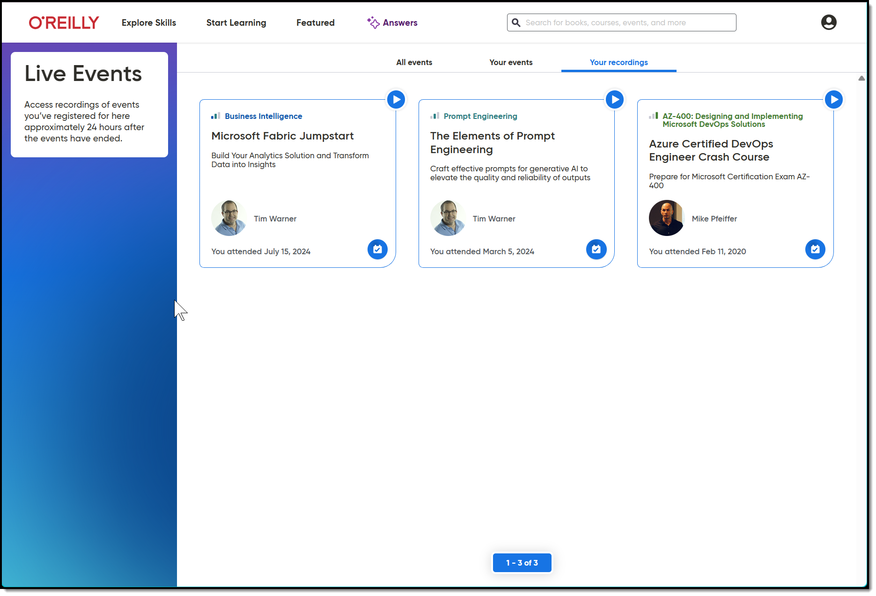
Session Recordings & Badge

Slide 6
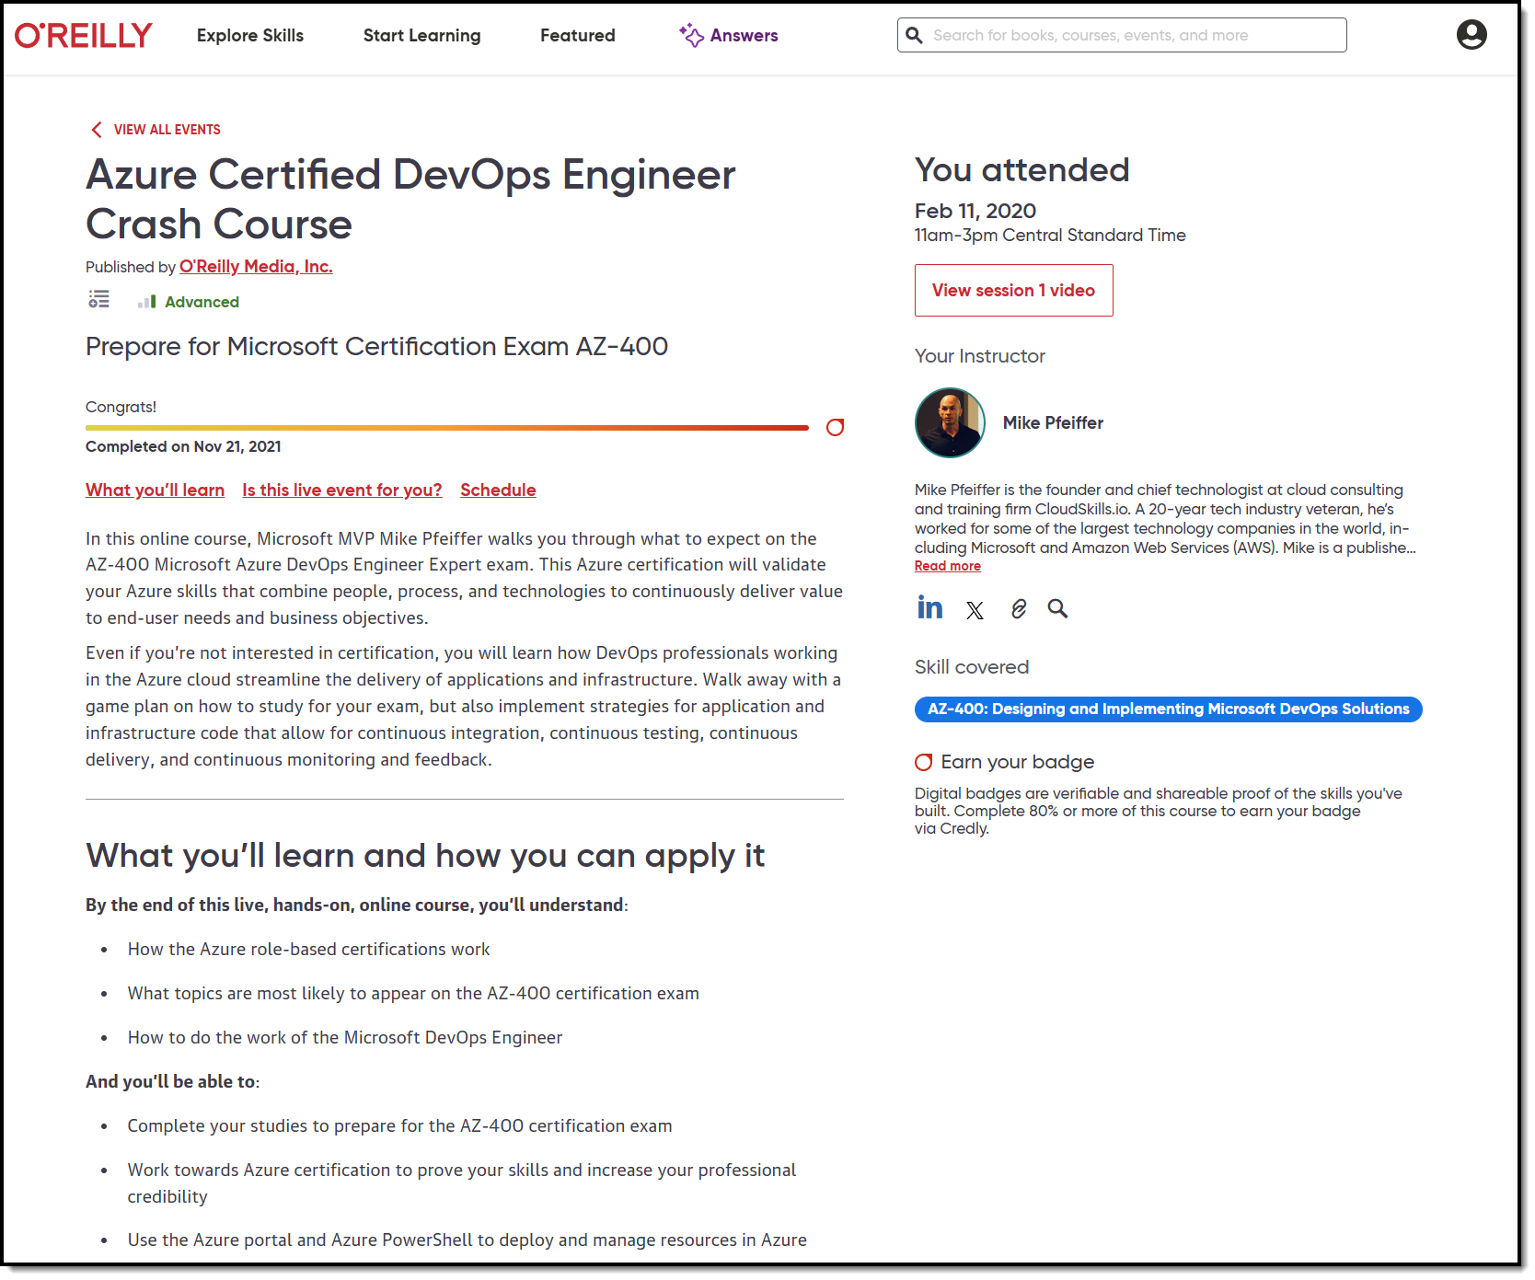
Session Recordings & Badge

Slide 7
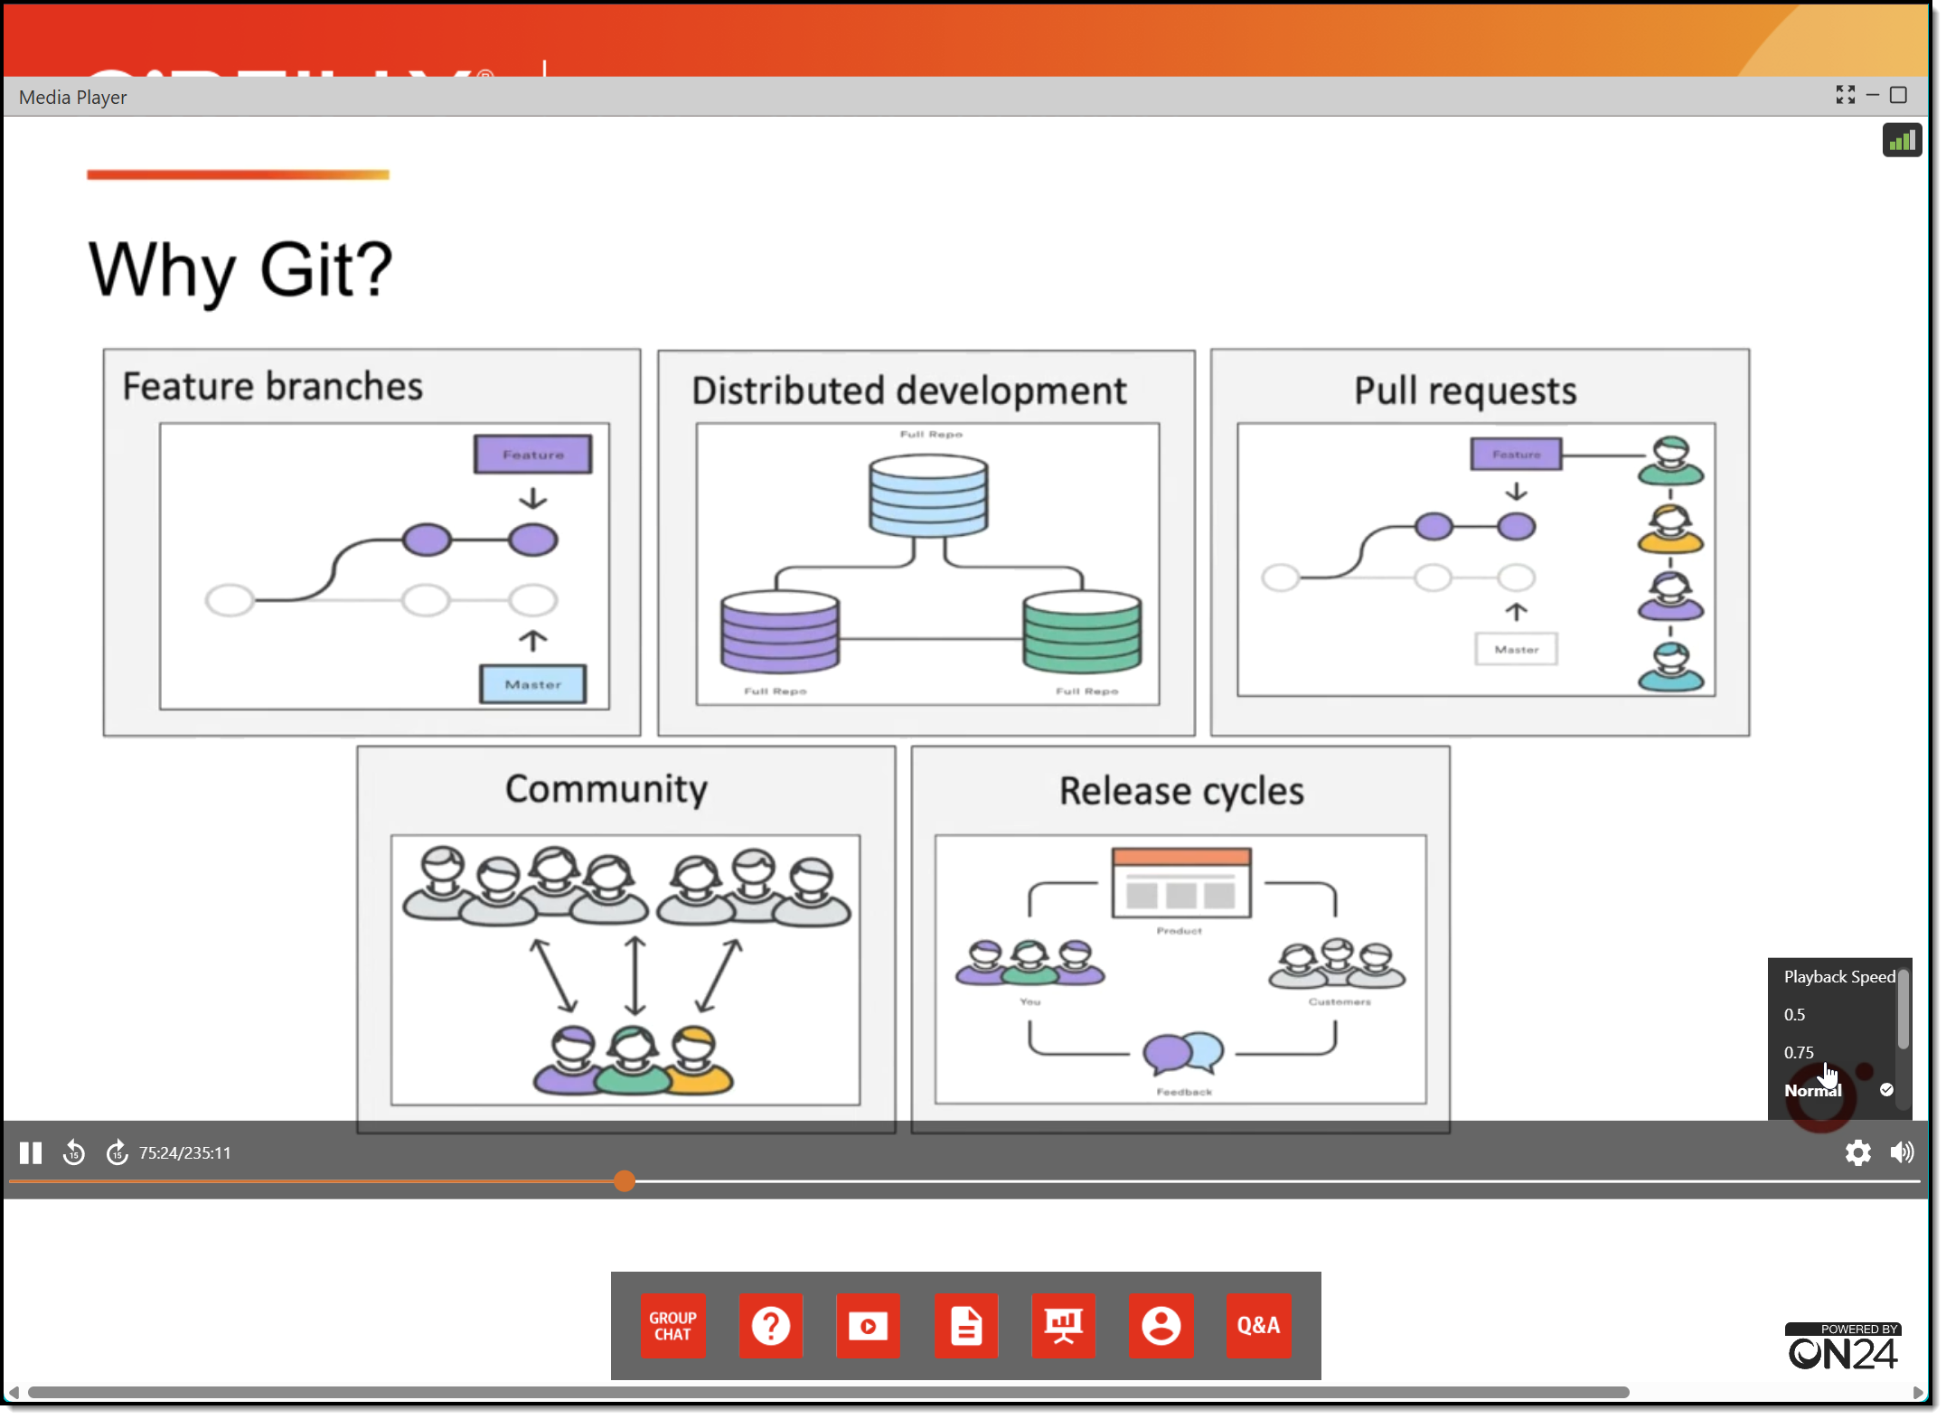
Session Recordings & Badge

Slide 8
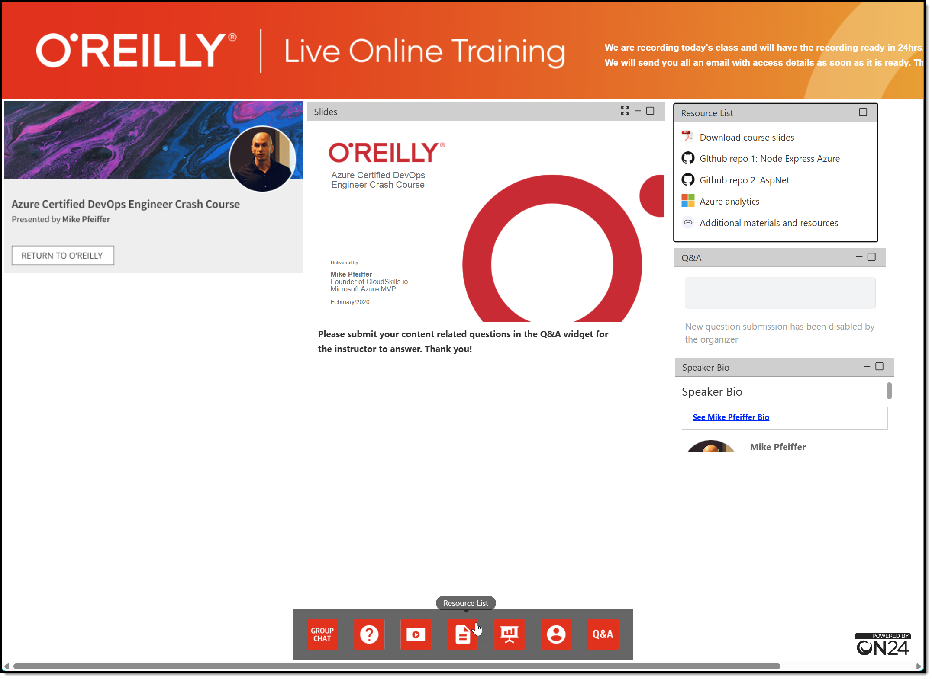
Session Recordings & Badge

Slide 9
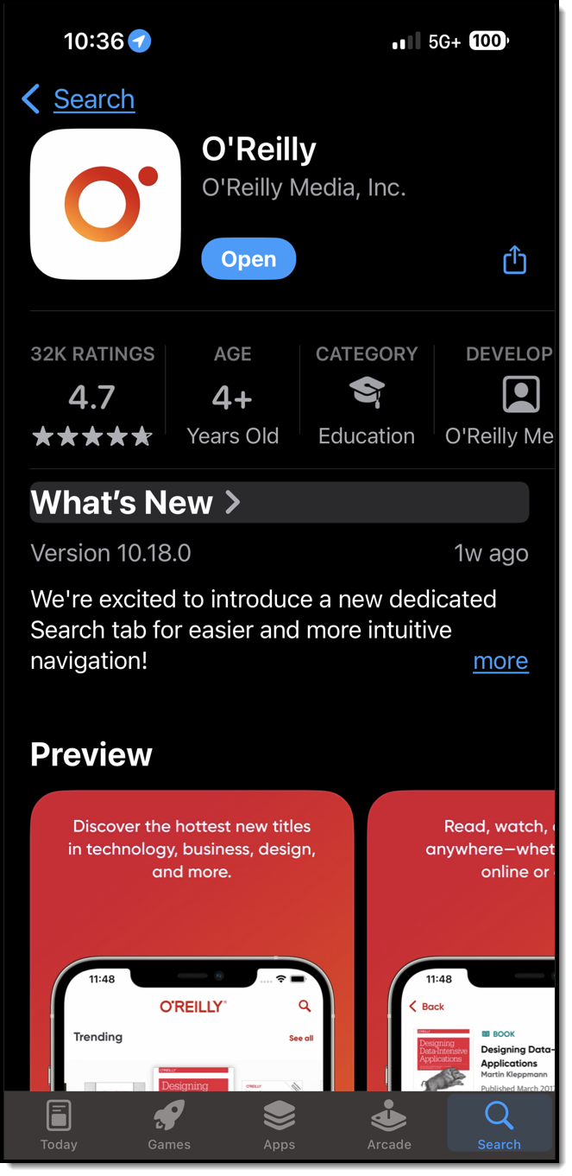
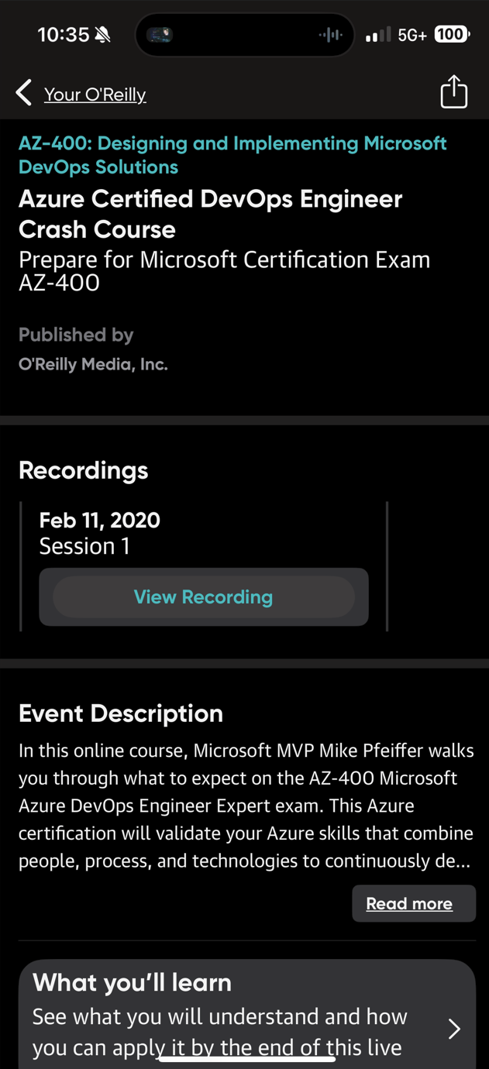
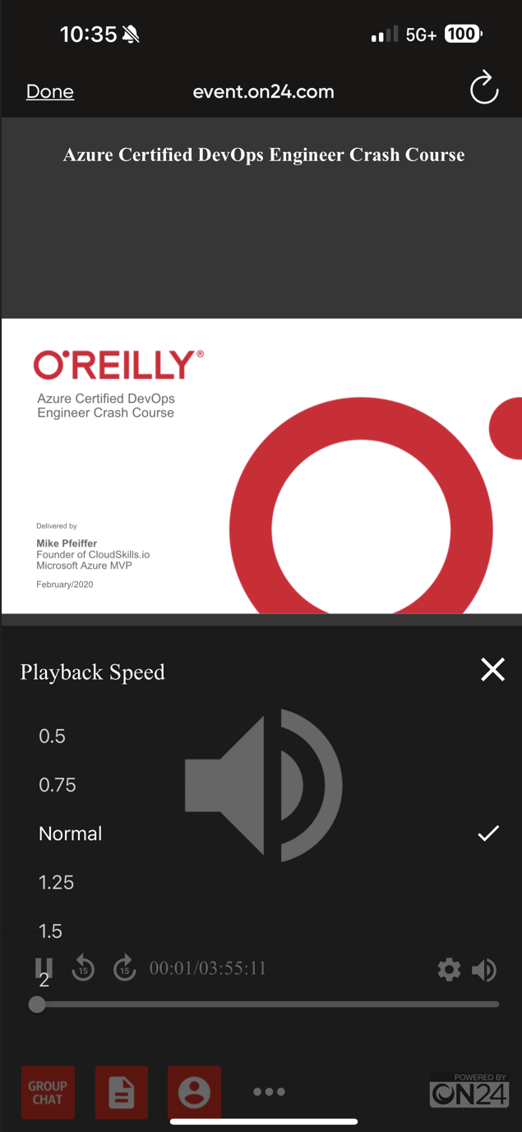
Session Recordings & Badge

Slide 10
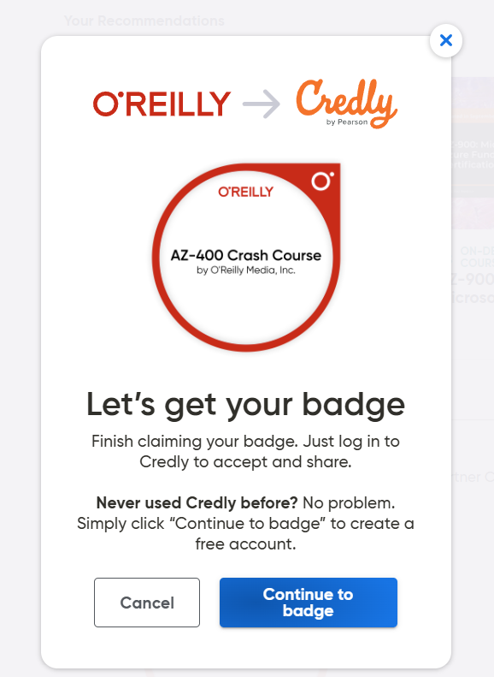
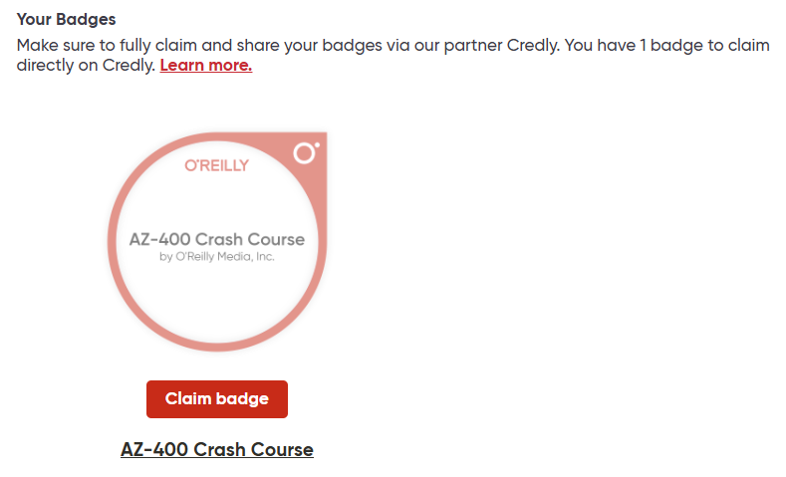
Session Recordings & Badge

Slide 11
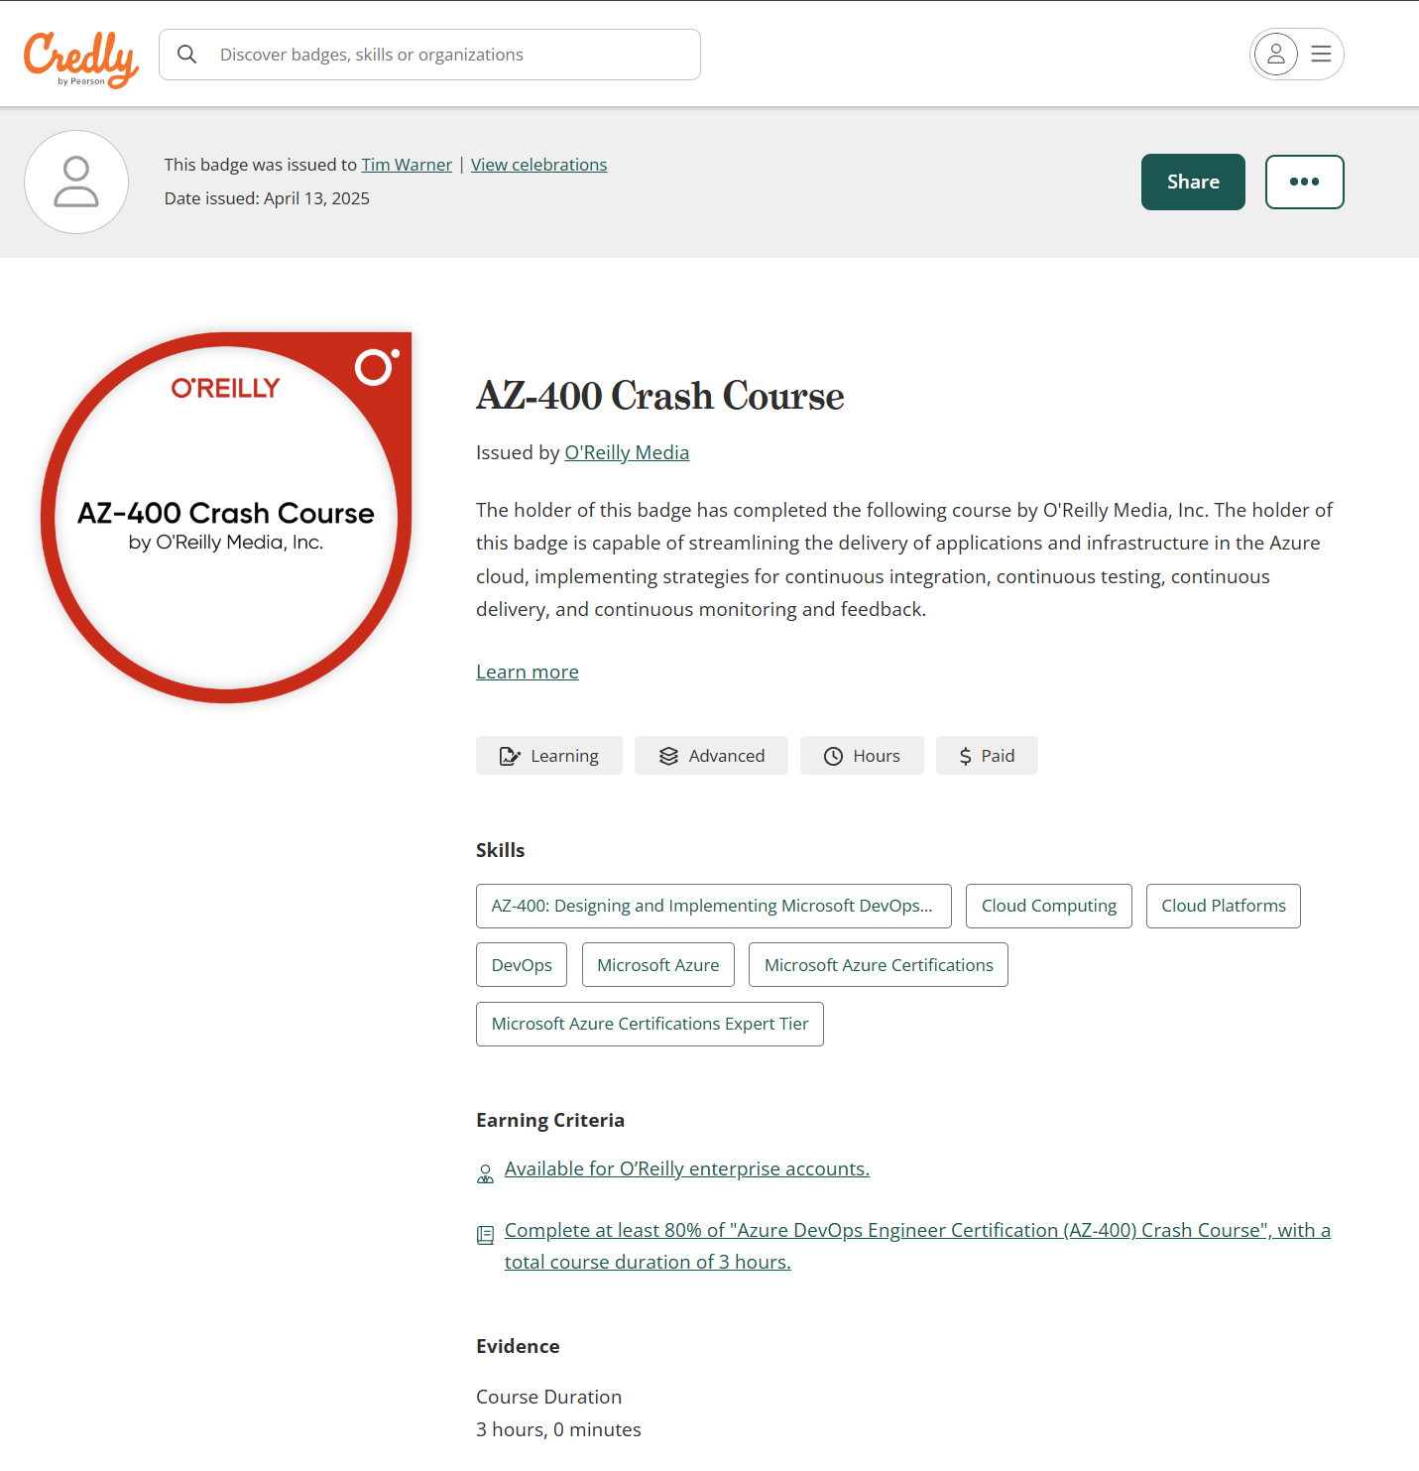
Session Recordings & Badge

Slide 12

Tim's Certification Study Model
Generative AI Support
Core Concepts (Docs)
Knowledge Checks (Tests)
Hands-On Skills (Labs)
Theory (Docs)

Slide 13

Thank you!
Course materials: go.techtrainertim.com/fabric
Contact: TechTrainerTim.com

Slide 14
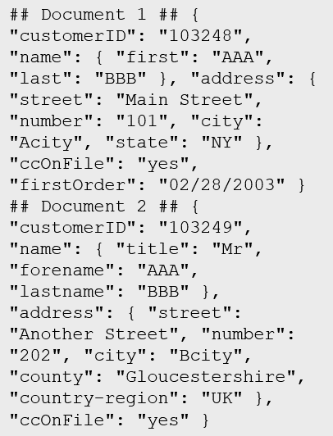
Data Types
Structured
Semi-structured
Unstructured
Table

Slide 15

Data Workload Types
Online Transactional Processing (OLTP)
Online Analytical Processing (OLAP)
Customer
CustomerID | CustomerName | CustomerPhone
Orders
OrderID | CustomerID | OrderDate
Data is periodically loaded, aggregated and stored in a cube
Data is stored one transaction at a time

Slide 16

Data Processing Types
Batch
Streaming

Slide 17
Data Processing

Slide 18
ETL
Azure Data Factory
Azure Stream Analytics

Slide 19
ELT
Azure Data Factory
Azure Synapse

Slide 20





Data Analytics
On-premises data
SQL Server, Oracle, fileshares, SAP
Data ingestion
Data storage
Data processing
Data visualization
Cloud data
Azure, AWS, GCP
SaaS data
Salesforce, Dynamics

Slide 21
Non-Binary Data Formats
CSV
Good for bandwidth-sensitive data loads
JSON
Clear, structured format with optional validation

Slide 22
Binary Data Formats
Optimized for splitting across compute nodes
Parquet, ORC: Columnar store
Fast read performance (compression) for analytical workloads
Avro: Row-based store that includes JSON
Schematized
Optimized for write performance

Slide 23
More on Parquet and Delta Lake (FOSS)
Apache Parquet
Open-source, columnar file format
Compressed and optimized for analytics
Used by Spark, SQL, and Power BI
Delta Lake
Built on top of Parquet
Adds ACID transactions and versioning
Supports updates, deletes, and time travel
Enables streaming + batch in one table

Slide 24
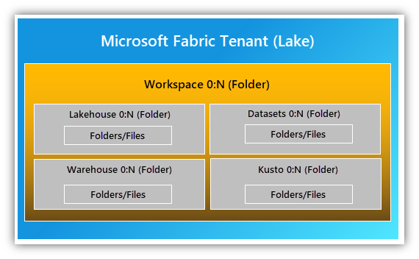
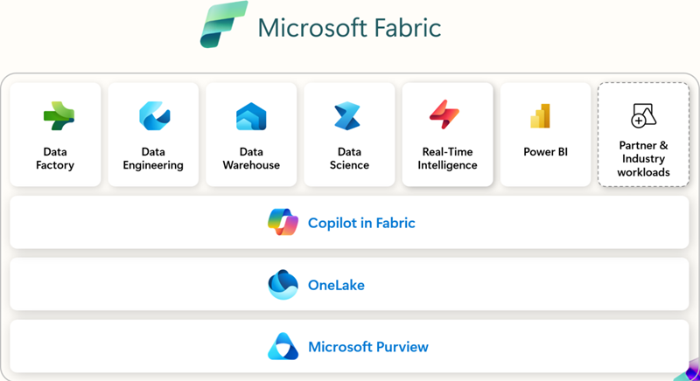
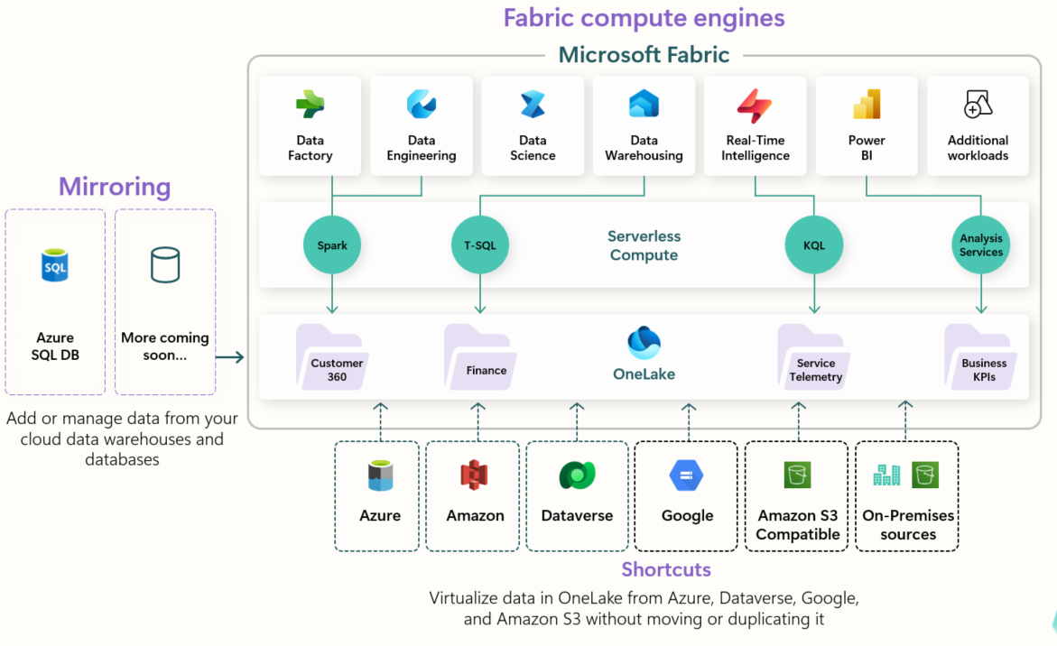
Microsoft Fabric Basic Architecture
go.techtrainertim.com/fab1

Slide 25
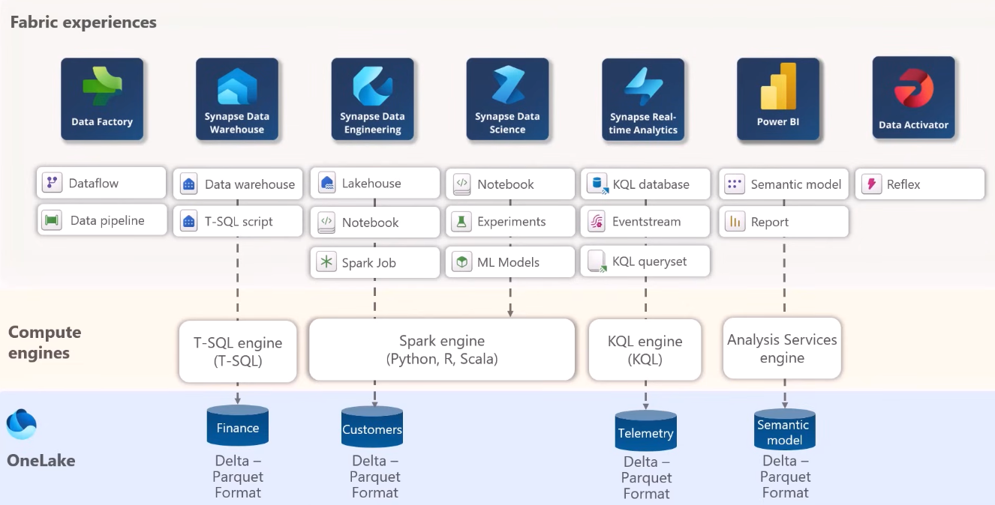
Microsoft Fabric Experiences
go.techtrainertim.com/fex

Slide 26
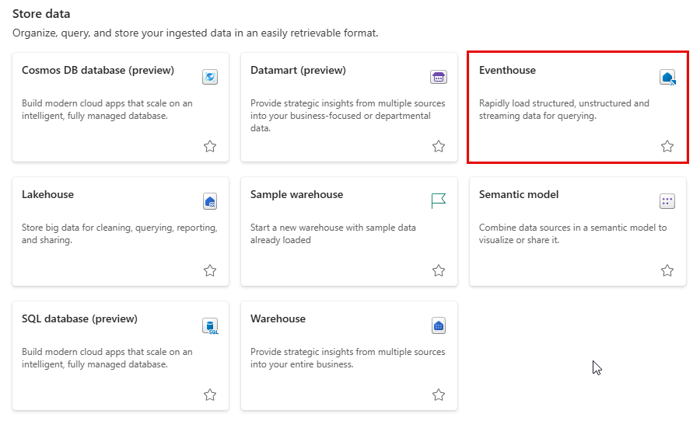
A Tale of (at Least) Three Houses
go.techtrainertim.com/blah

Slide 27
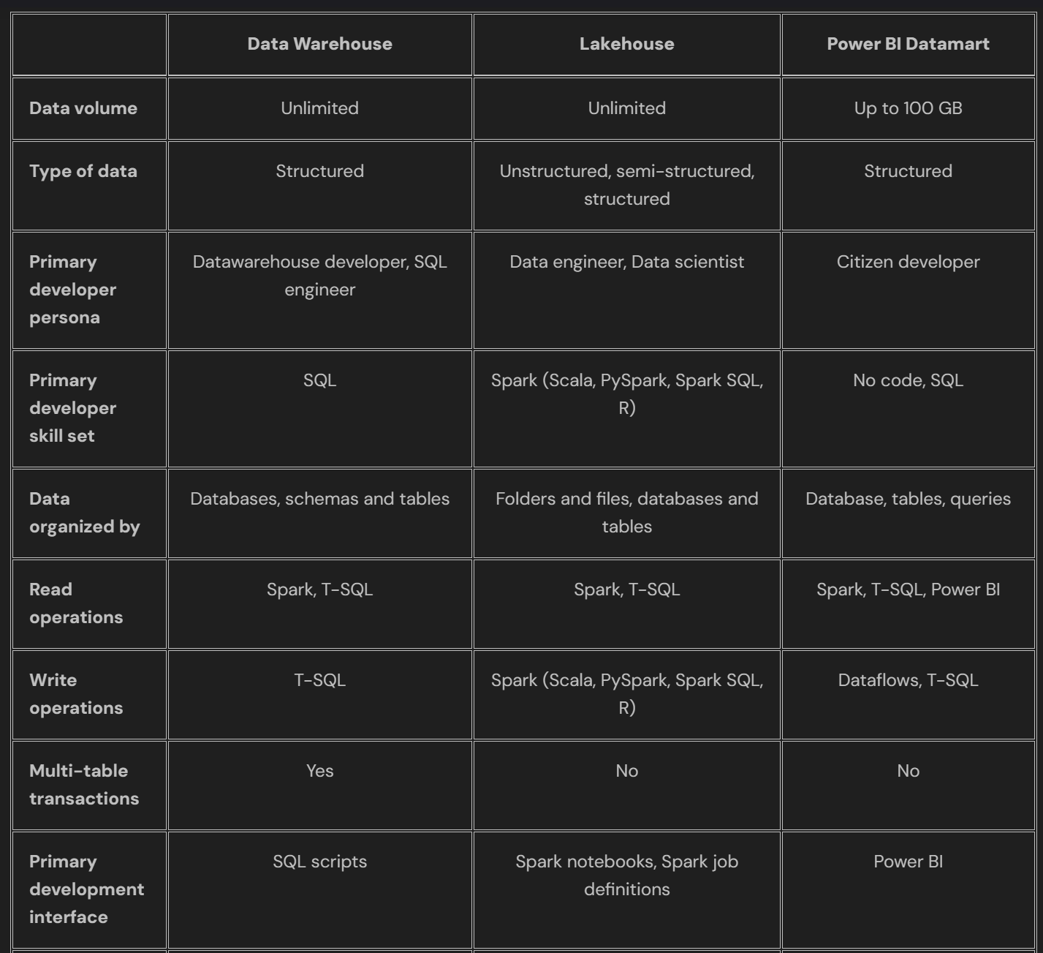
Feature Comparison
go.techtrainertim.com/aa

Slide 28
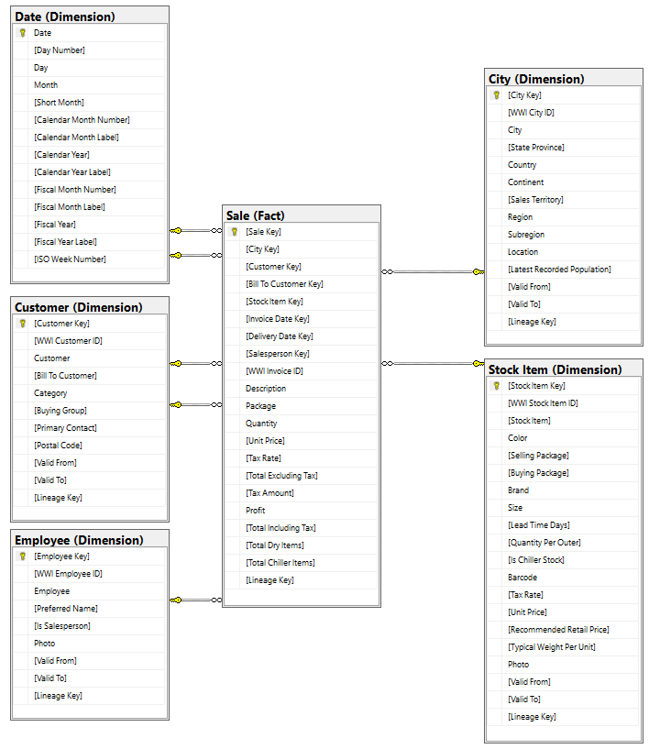
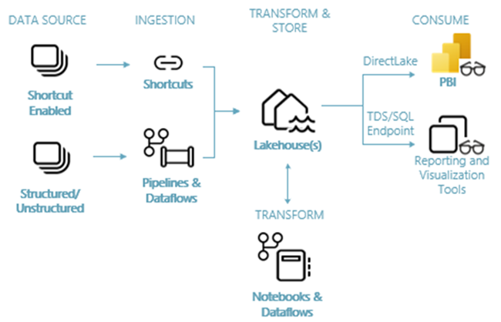
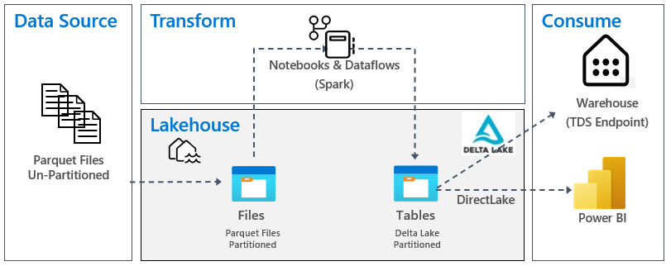
Lakehouse Scenario
go.techtrainertim.com/lcs

Slide 29
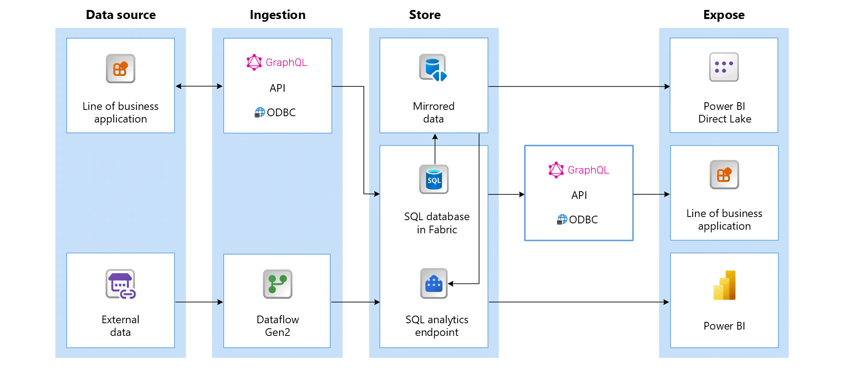
SQL Database Scenario
go.techtrainertim.com/sql

Slide 30
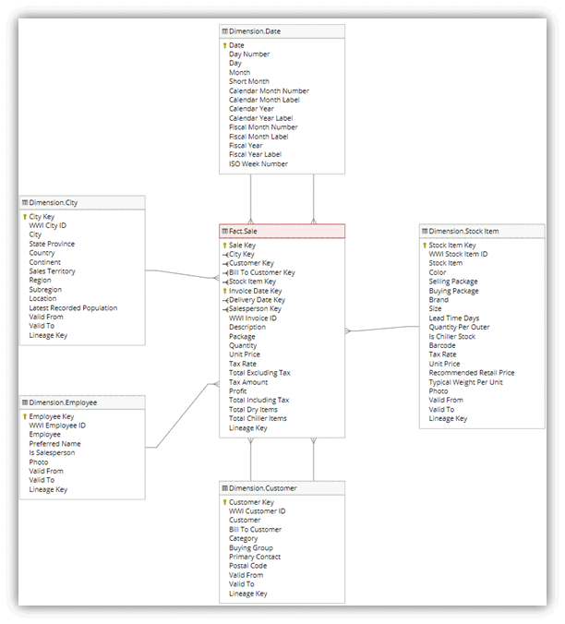
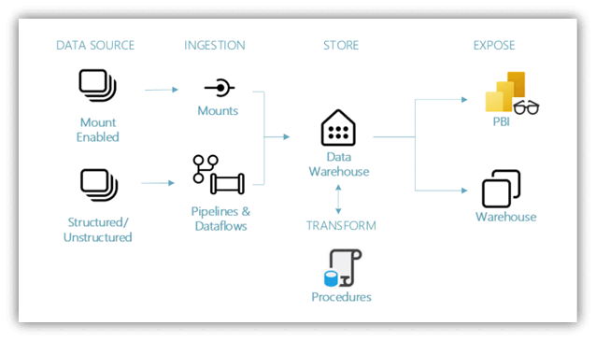
Warehouse Scenario
go.techtrainertim.com/sw1

Slide 31
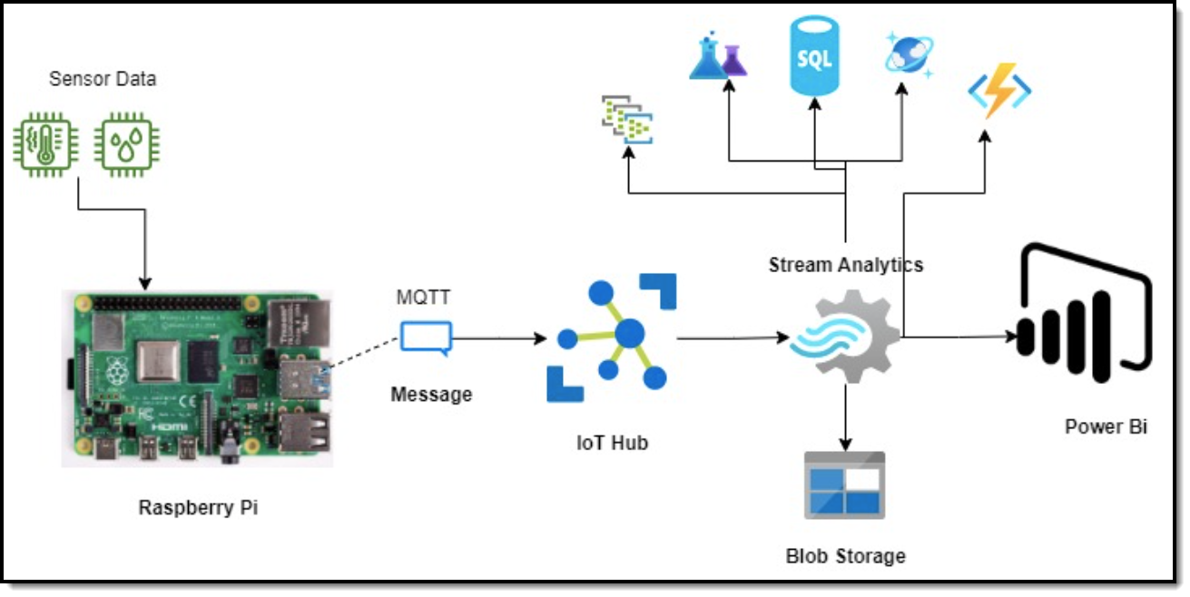
Streaming Data Scenario
go.techtrainertim.com/rasp

Slide 32
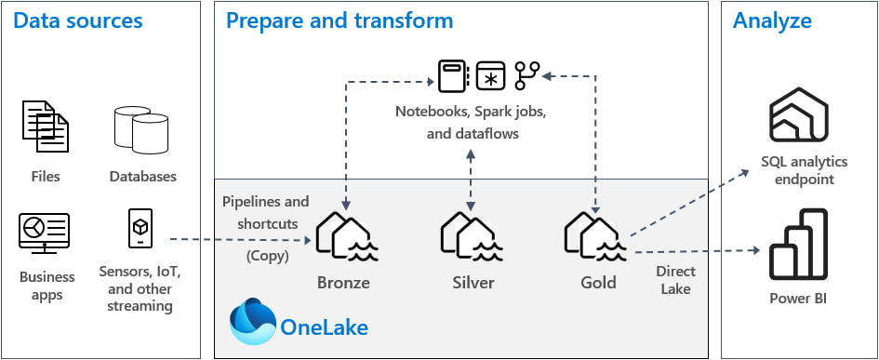
Medallion Architecture
go.techtrainertim.com/med

Slide 33
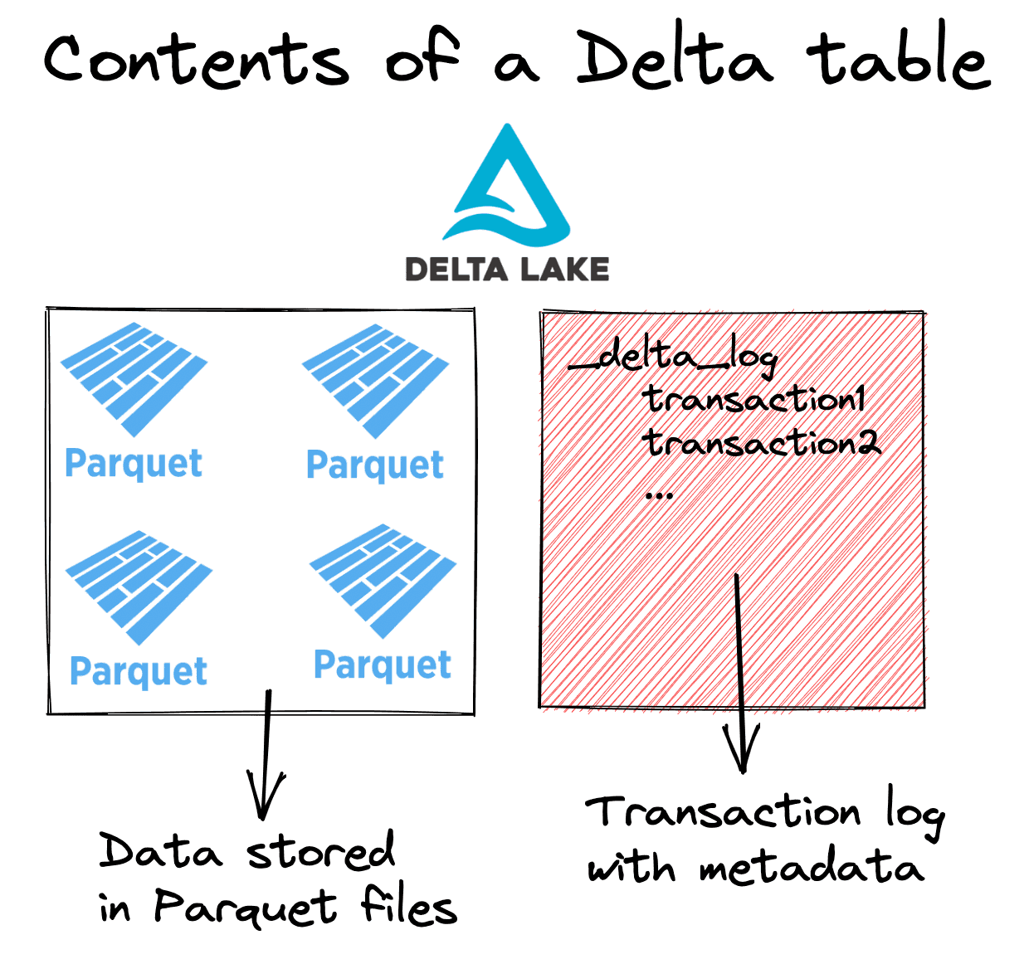
Delta Tables
go.techtrainertim.com/del

Slide 34
A Tale of Three Houses
go.techtrainertim.com/blah

Slide 35
A Tale of Three Houses
go.techtrainertim.com/blah

Slide 36
A Tale of Three Houses
go.techtrainertim.com/blah

Slide 37
A Tale of Three Houses
go.techtrainertim.com/blah

Slide 38
A Tale of Three Houses
go.techtrainertim.com/blah

Slide 39
A Tale of Three Houses
go.techtrainertim.com/blah

Slide 40
Data Fundamentals

Slide 41
Blob Storage and Data Lake

Slide 42
Azure Blob Storage
Block blobs
Page blobs
Append blobs
Has a maximum size of 4.7TB
Best for storing large, discrete, binary objects that changes infrequently
Each individual block can store up to 100MB of data
A block blob can contain up to 50000 blocks
Can hold up to 8TB of data
Is organized as a collection of fixed sized-512 byte pages
Used to implement virtual disk storage for virtual machines
The maximum size is just over 195GB
Is a block blob that is used to optimize append operations
Each individual block can store up to 4MB of data

Slide 43
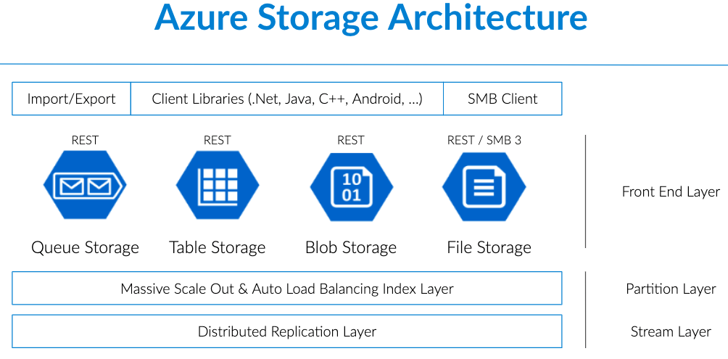
Blob Storage

Slide 44

ADLS Gen 2
A repository of data for your Modern Data Warehouse
Organises data into directories for improved file access
Supports POSIX and RBAC permissions
It is compatible with Hadoop Distributed File System
Store
Azure Data Lake Storage
High performance data lake available in all 54 Azure regions

Slide 45
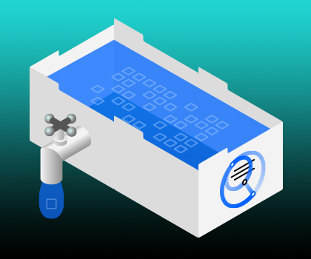
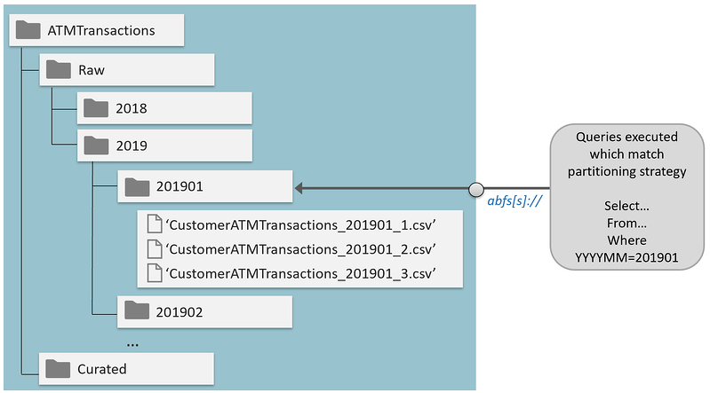
Data Lake Storage Gen 2

Slide 46
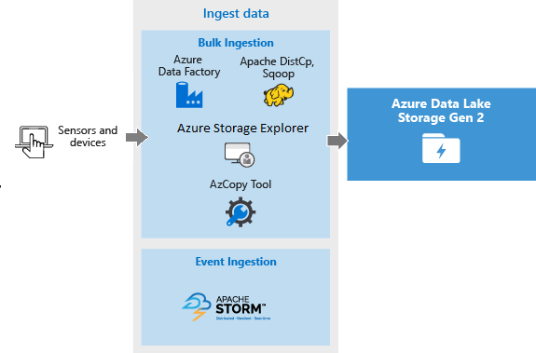
Azure Data Lake Storage Gen 2

Slide 47
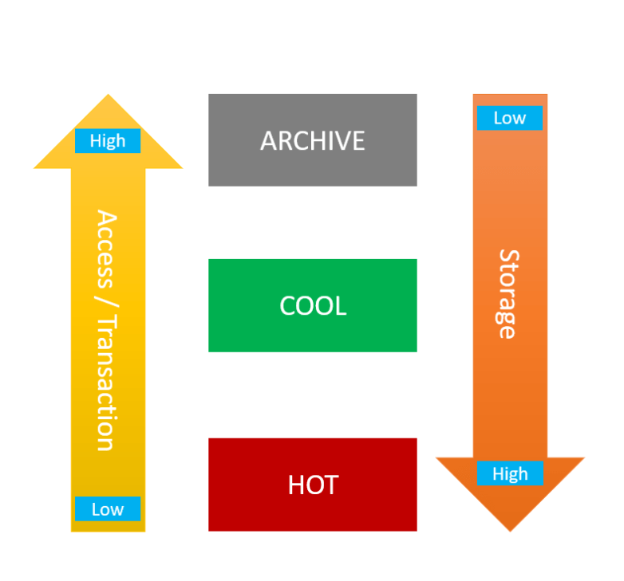
Access Tiers & Lifecycle Management

Slide 48
Azure SQL Products

Slide 49
Relational Database Tables
Customers
CustomerID | CustomerName | CustomerPhone
100 | Muisto Linna | XXX-XXX-XXXX
101 | Noam Maoz | XXX-XXX-XXXX
102 | Vanja Matkovic | XXX-XXX-XXXX
103 | Qamar Mounir | XXX-XXX-XXXX
104 | Zhenis Omar | XXX-XXX-XXXX
105 | Claude Paulet | XXX-XXX-XXXX
106 | Alex Pettersen | XXX-XXX-XXXX
107 | Francis Ribeiro | XXX-XXX-XXXX
Data is stored in a table
Table consists of rows and columns
All rows have same # of columns
Each column is defined by a datatype

Slide 50
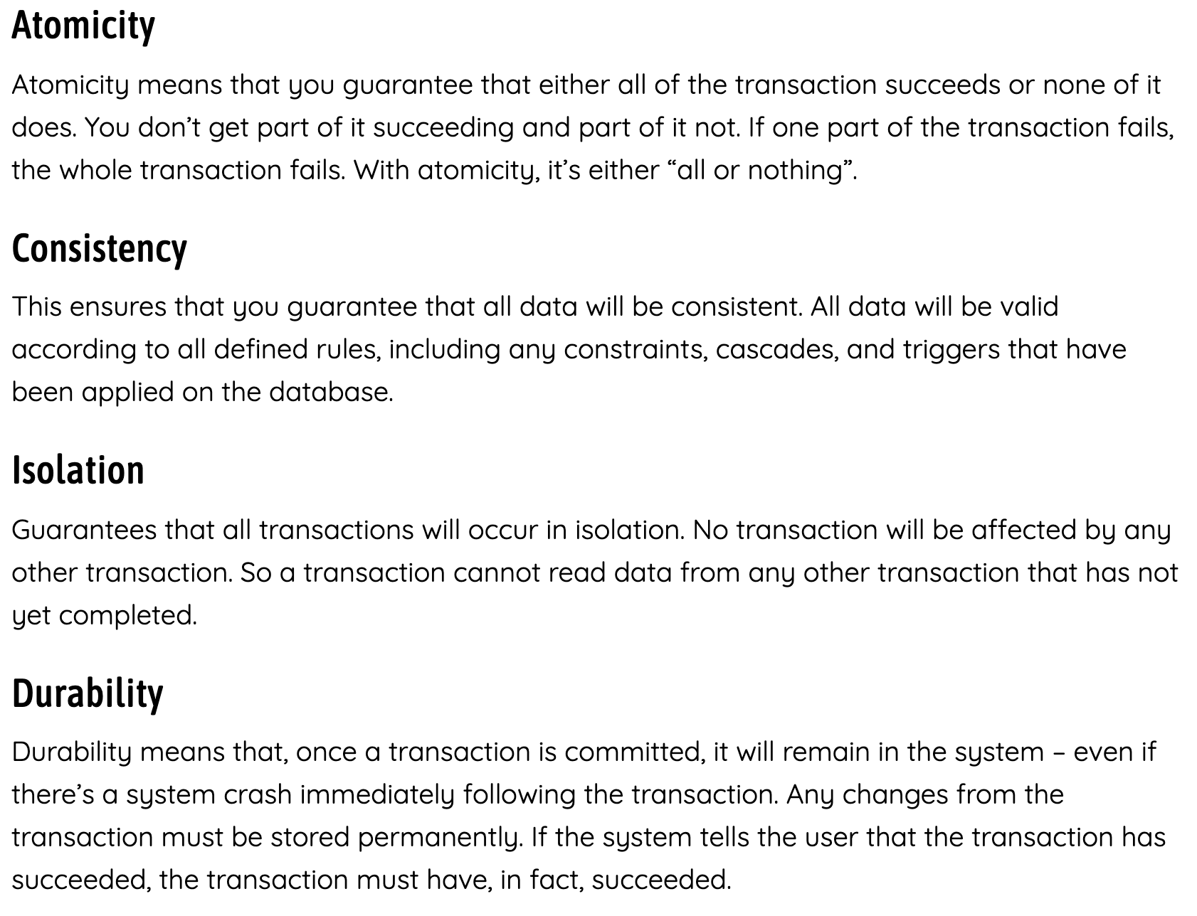
ACID Principle

Slide 51
Normalization
Customers
CustomerID | CustomerName | CustomerPhone
100 | Muisto Linna | XXX-XXX-XXXX
101 | Noam Maoz | XXX-XXX-XXXX
102 | Vanja Matkovic | XXX-XXX-XXXX
103 | Qamar Mounir | XXX-XXX-XXXX
104 | Zhenis Omar | XXX-XXX-XXXX
105 | Claude Paulet | XXX-XXX-XXXX
106 | Alex Pettersen | XXX-XXX-XXXX
Orders
OrderID | CustomerName | CustomerPhone
AD100 | Noam Maoz | XXX-XXX-XXXX
AD101 | Noam Maoz | XXX-XXX-XXXX
AD102 | Noam Maoz | XXX-XXX-XXXX
AX103 | Qamar Mounir | XXX-XXX-XXXX
AS104 | Qamar Mounir | XXX-XXX-XXXX
AR105 | Claude Paulet | XXX-XXX-XXXX
MK106 | Muisto Linna | XXX-XXX-XXXX
Data is normalized to:
Reduce storage
Avoid data duplication
Improve data quality

Slide 52

Table Relationships
Customers
CustomerID | CustomerName | CustomerPhone
100 | Muisto Linna | XXX-XXX-XXXX
101 | Noam Maoz | XXX-XXX-XXXX
102 | Vanja Matkovic | XXX-XXX-XXXX
103 | Qamar Mounir | XXX-XXX-XXXX
104 | Zhenis Omar | XXX-XXX-XXXX
105 | Claude Paulet | XXX-XXX-XXXX
106 | Alex Pettersen | XXX-XXX-XXXX
Orders
OrderID | CustomerID | SalesPersonID
AD100 | 101 | 200
AD101 | 101 | 200
AD102 | 101 | 200
AX103 | 103 | 201
AS104 | 103 | 201
AR105 | 105 | 200
MK106 | 105 | 201
In a normalized database schema:
Primary Keys and Foreign keys are used to define relationships
No data duplication exists (other than key values in 3rd Normal Form (3NF)
Data is retrieved by joining tables together in a query

Slide 53
SQL Statement Categories
DML
DDL
DCL
Data Manipulation Language
Used to query and manipulate data
SELECT, INSERT, UPDATE, DELETE
Data Definition Language
Used to define database objects
CREATE, ALTER, DROP, RENAME
Data Control Language
Used to manage security permissions
GRANT, REVOKE, DENY

Slide 54
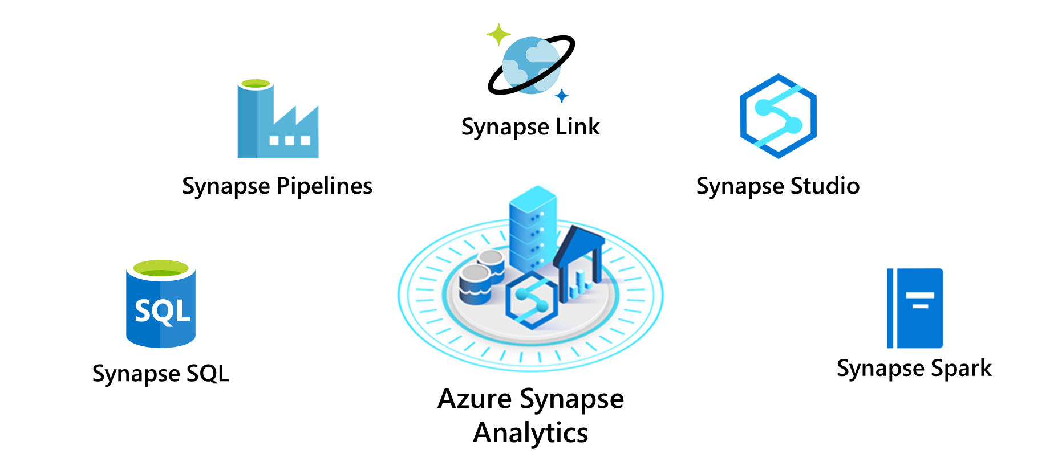
Azure Synapse
PolyBase

Slide 55
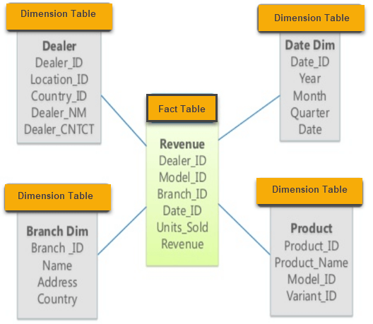
Data Warehouse Star Schema

Slide 56
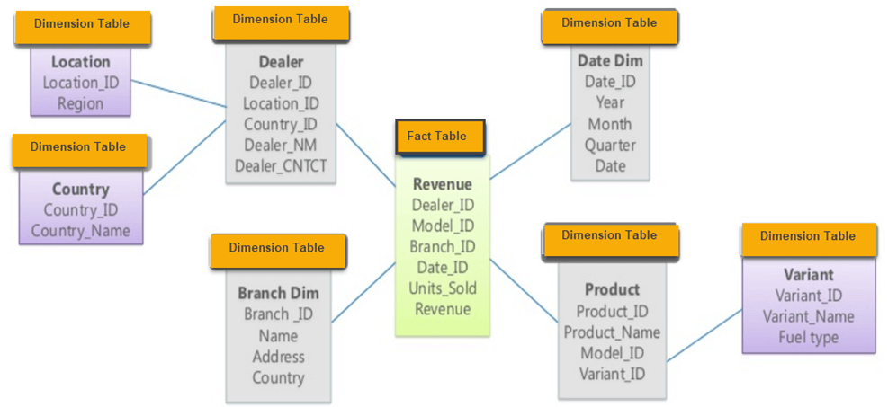
Data Warehouse Snowflake Schema

Slide 57
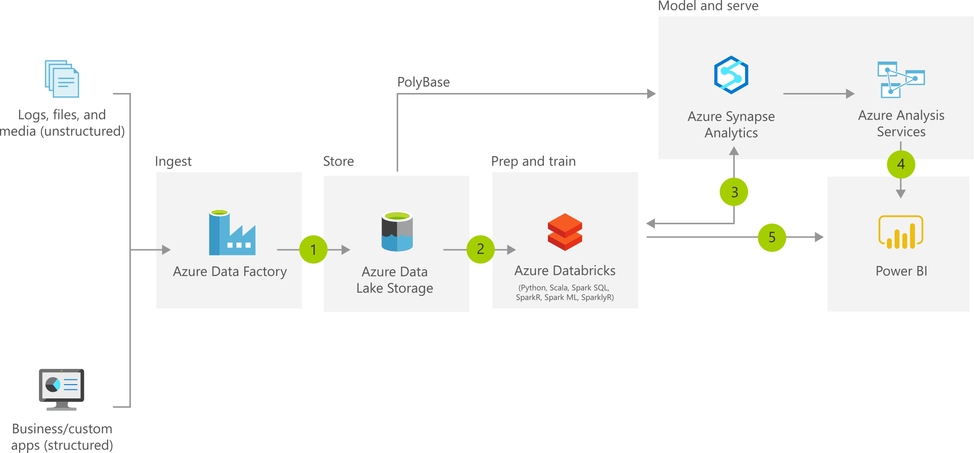
Azure Synapse

Slide 58
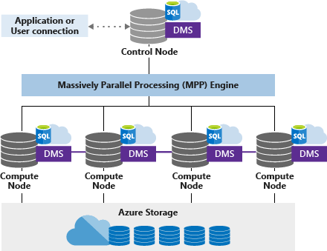
Azure Synapse SQL Pool (DW) Architecture

Slide 59
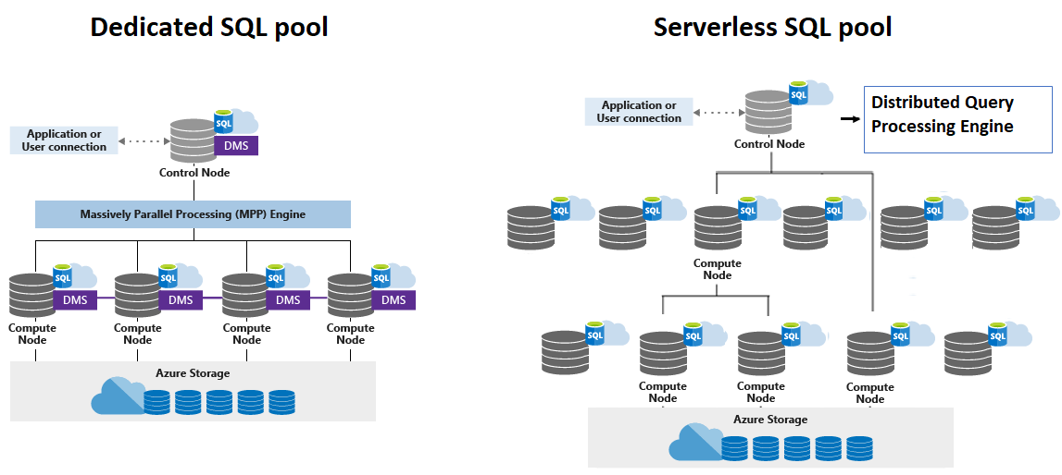
Synapse SQL Pool Types

Slide 60
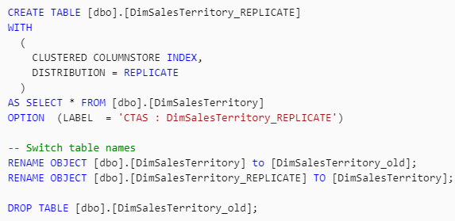
Azure Synapse Table Distribution Modes
https://timw.info/0jl

Slide 61
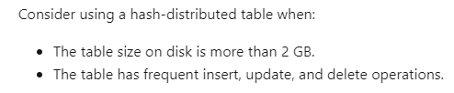
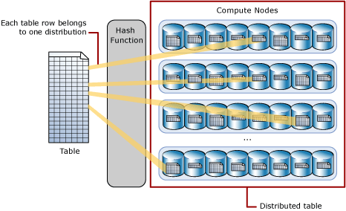
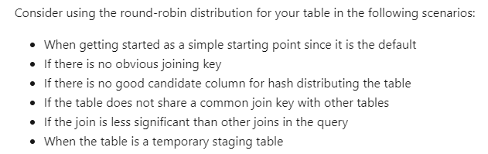
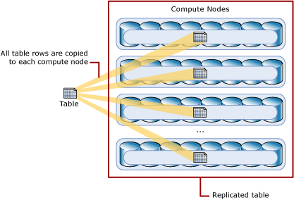
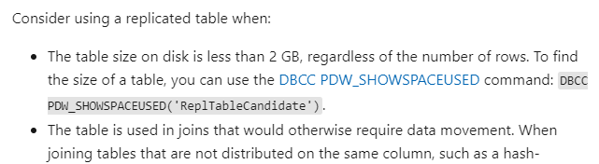
Azure Synapse Table Distribution Modes
https://timw.info/0jl

Slide 62
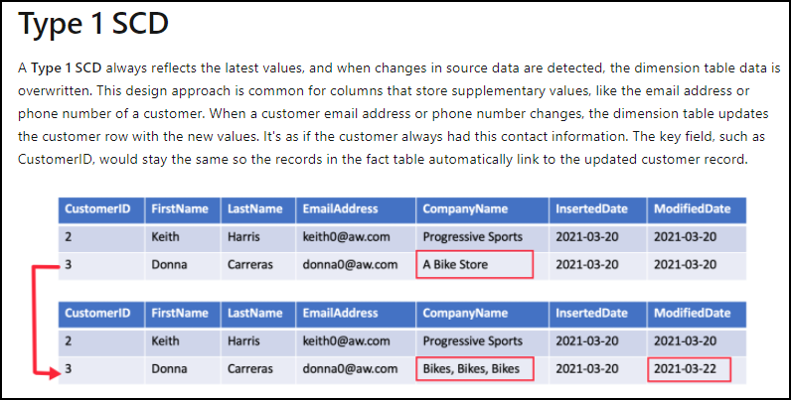
Slowly Changing Dimensions (SCD)

Slide 63
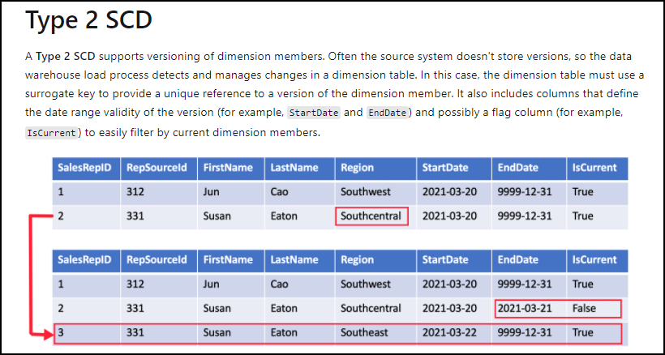
Slowly Changing Dimensions (SCD)

Slide 64
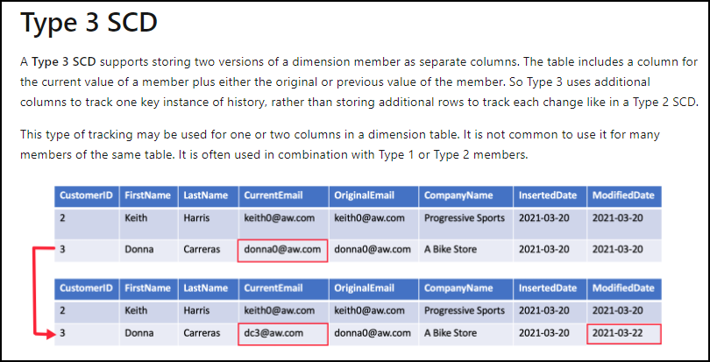
Slowly Changing Dimensions (SCD)

Slide 65
Azure Databricks

Slide 66
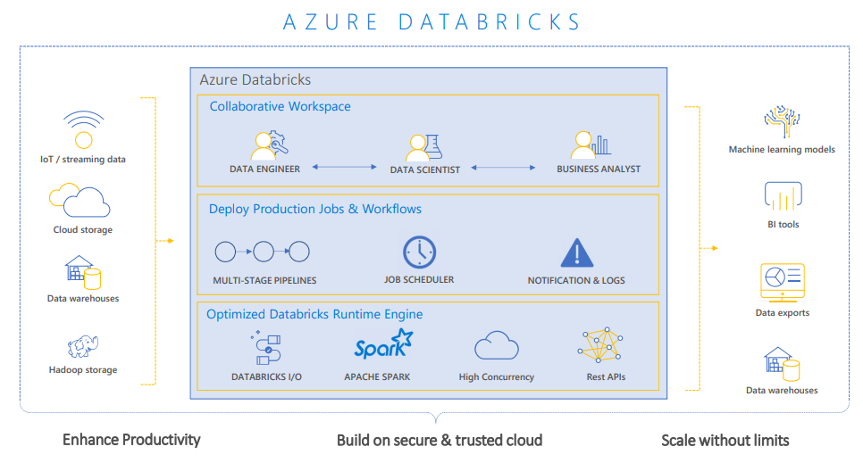
Azure Databricks

Slide 67
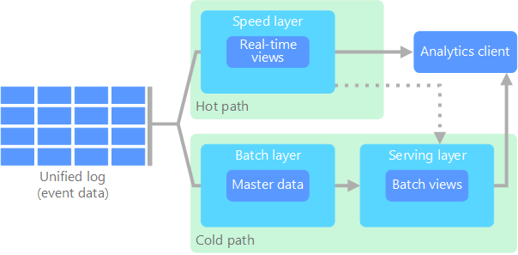
Lambda Architecture

Slide 68
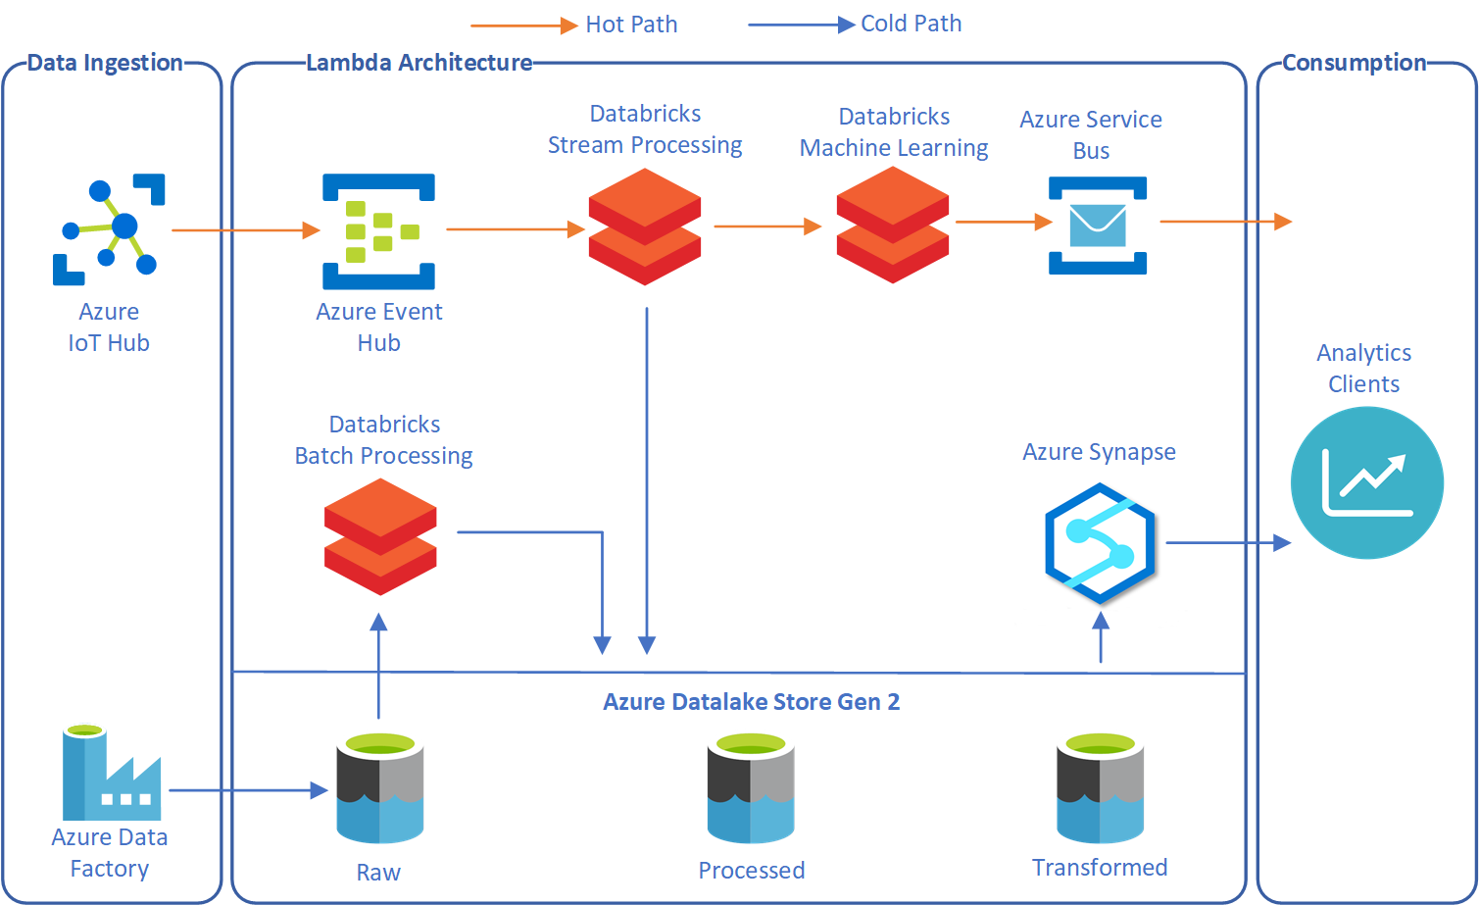
Lambda Architecture with Databricks

Slide 69

Kappa Architecture

Slide 70

Kappa Architecture with Databricks

Slide 71
Data Security

Slide 72
Network security
Securing your network from attacks and unauthorized access is an important part of any architecture
Internet protection
Firewalls
DDoS protection
Network security groups
Assess the resources that are internet-facing, and to only allow inbound and outbound communication where necessary. Make sure you identify all resources that are allowing inbound network traffic of any type
To provide inbound protection at the perimeter, there are several choices:
Azure Firewall
Azure Application Gateway
Azure Storage Firewall
The Azure DDoS Protection service protects your Azure applications by scrubbing traffic at the Azure network edge before it can impact your service’s availability
Network Security Groups allow you to filter network traffic to and from Azure resources in an Azure virtual network. An NSG can contain multiple inbound and outbound security rules
Notes:
Instructor notes
Inform the students that for in-depth understanding of network security, an understanding of IP addresses, protocol and the technologies would be required to manage this. It would difficult to learn all of this, as well as the Data Engineering responsibilities that the students have.
You should be familiar of firewall configurations of data services, but you should work with a Security Administrator when it comes to considering DDOS and Network Security group management

Slide 73
Identity and access
Authentication
This is the process of establishing the identity of a person or service looking to access a resource. Azure Active Directory is a cloud-based identity service that provide this capability
Azure Active Directory features
Single sign-on
Enables users to remember only one ID and one password to access multiple applications
Apps & device management
You can manage your cloud and on-premises apps and devices and the access to your organizations resources
Identity services
Manage Business to business (B2B) identity services and Business-to-Customer (B2C) identity services
Authorization
This is the process of establishing what level of access an authenticated person or service has. It specifies what data they're allowed to access and what they can do with it. Azure Active Directory also provides this capability
Notes:
Instructor notes
Many of your students will likely be aware of authentication and authorization. If not, make sure that they are familiar with the basic concepts. Be aware, that they may consider this in the context of user accounts, therefore its important to point out that this can occur through other methods as well such as Shared Access Key for storage accounts.
From a user and service account perspective, go into the benefits of Azure Active Directory, and how it can be used to manage devices and apps too.

Slide 74
Encryption
Encryption at rest
Data at rest is the data that has been stored on a physical medium. This could be data stored on the disk of a server, data stored in a database, or data stored in a storage account
Encryption on Azure
Raw encryption
Enables the encryption of:
Azure Storage
V.M. Disks
Disk Encryption
Database encryption
Enables the encryption of databases using:
Transparent Data Encryption
Encrypting secrets
Azure Key Vault is a centralized cloud service for storing your application secrets
Encryption in transit
Data in transit is the data actively moving from one location to another, such as across the internet or through a private network. Secure transfer can be handled by several different layers
Notes:
Instructor notes
This provides a holistic view of encryption within Azure, not just focused on database encryption. Understanding the difference between encryption at rest v encryption in transit is a good example of providing end to end security of data. Not just in the storage, but also in the transmission of data too.
It is worth exploring Azure Key Vault here with the students:
https://docs.microsoft.com/en-us/azure/key-vault/key-vault-overview

Slide 75
Encryption
Encryption at rest
Data at rest is the data that has been stored on a physical medium. This could be data stored on the disk of a server, data stored in a database, or data stored in a storage account
Encryption on Azure
Raw encryption
Enables the encryption of:
Azure Storage
V.M. Disks
Disk Encryption
Database encryption
Enables the encryption of databases using:
Transparent Data Encryption
Encrypting secrets
Azure Key Vault is a centralized cloud service for storing your application secrets
Encryption in transit
Data in transit is the data actively moving from one location to another, such as across the internet or through a private network. Secure transfer can be handled by several different layers
Notes:
Instructor notes
This provides a holistic view of encryption within Azure, not just focused on database encryption. Understanding the difference between encryption at rest v encryption in transit is a good example of providing end to end security of data. Not just in the storage, but also in the transmission of data too.
It is worth exploring Azure Key Vault here with the students:
https://docs.microsoft.com/en-us/azure/key-vault/key-vault-overview

Slide 76

Azure SQL Database Firewall Rules

Slide 77

Azure SQL Database DDM

Slide 78

Azure SQL Database Always Encrypted

Slide 79

Azure Data Factory

Slide 80

Power BI

Slide 81
What are data streams
Data streams:
In the context of analytics, data streams are event data generated by sensors or other sources that can be analyzed by another technology
Data streams are used to:
Analyze data:
Continuously analyze data to detect issues and understand or respond to them
Understand systems:
Understand component or system behavior under various conditions to fuel further enhancements of said system
Trigger actions:
Trigger specific actions when certain thresholds are identified
Data stream processing approach:
There are two approaches. Reference data is streaming data that can be collected over time and persisted in storage as static data. In contrast, streaming data have relatively low storage requirements. And run computations in sliding windows
Notes:
Instructor notes
It is important to make the distinction between reference data and streaming data and the impact this can have on real time analytics.

Slide 82
Event processing
The process of consuming data streams, analyzing them, and deriving actionable insights out of them is called Event Processing and has three distinct components:
Event producer
Examples include sensors or processes that generate data continuously such as a heart rate monitor or a highway toll lane sensor
Event processor
An engine to consume event data streams and deriving insights from them. Depending on the problem space, event processors either process one incoming event at a time (such as a heart rate monitor) or process multiple events at a time (such as a highway toll lane sensor)
Event consumer
An application which consumes the data and takes specific action based on the insights. Examples of event consumers include alert generation, dashboards, or even sending data to another event processing engine
Notes:
Instructor notes
There are several services available for real-time analytics and streaming processing on Azure. Regardless of the technology used, they all work with three distinct components:
- Event Producers
- Event Processors
Event Consumers
The two main real-time analytics and streaming processing technologies on Azure are Stream Analytics, and Kafka. The following documentation gives a great differentiation between the two:
https://docs.microsoft.com/en-us/azure/stream-analytics/streaming-technologies

Slide 83
Processing events with Azure Stream Analytics
Microsoft Azure Stream Analytics is an event processing engine. It enables the consumption and analysis of high volumes of streaming data in real time
Source
Ingestion
Analytical engine
Destination
Sensors
Systems
Applications
Event Hubs
IoT Hubs
Azure Blob Store
Stream Analytics Query Language
.NET SDK
Azure Data Lake
Cosmos DB
SQL Database
Blob Store
Power BI
Notes:
Instructor notes
Explore the range of sources that can be used to produce data, and see if any students make use of this. It is also important to look at the difference between the various ingestion technologies. This course does not focus on IoT Hubs as there is a separate course being release on IoT in 2020, instead the focus will be on Event Hubs.
When going through the Analytical engine, focus on the Stream Analytics Query language. Tell the students if they are familiar with Transact-SQL then they will feel comfortable with the language, and they will explore an example in the lab.

Slide 84
Create an Event Hub
Create an event hub namespace
Create an event hub
In the Azure portal, select NEW, type Event Hubs, and then select Event Hubs from the resulting search. Then select Create
Provide a name for the event hub, and then create a resource group. Specify xx-name-eh and xx-name-rg respectively, XX- represent your initials to ensure uniqueness of the Event Hub name and Resource Group name
Click the checkbox to Pin to the dashboard, then select the Create button
After the deployment is complete, click the xx-name-eh event hub on the dashboard
Then, under Entities, select Event Hubs
To create the event hub, select the + Event Hub button. Provide the name socialstudy-eh, and then select Create
To grant access to the event hub, we need to create a shared access policy. Select the socialstudy-eh event hub when it appears, and then, under Settings, select Shared access policies
Under Shared access policies, create a policy with MANAGE permissions by selecting + Add. Give the policy the name of xx-name-eh-sap, check MANAGE, and then select Create
Select your new policy after it has been created, and then select the copy button for the CONNECTION STRING – PRIMARY KEY entity
Paste the CONNECTION STRING – PRIMARY KEY entity into Notepad, this is needed later in the exercise
Leave all windows open
Notes:
Instructor notes
This slide outlines the steps required to create an Event Hub Namespace, and an Event Hub. It is recommended that you log into the Azure portal and demonstrate the creation of this.

Slide 85
Azure Stream Analytics workflow
Complex event processing of Stream Data in Azure
Input Adapter
Complex Event Processor
Output Adapter
Notes:
Instructor notes
Azure Stream Analytics provides event processing of stream data as a service. Somewhat narrower in scope than Storm on HDInsight, Azure Stream Analytics provides a simple and very cost-effective way to process events. For instance, analyze streams of data for time-sequence relationships, all with a SQL-like query. Output data to Power BI to provide near-real-time reporting.

Slide 86

Start a Stream Analytics Job
Notes:
Instructor notes
You can either use this screenshot to go through the steps required to start an Azure Stream Analytics Job, alternatively, log into the Azure portal to see the latest GUI version.

Slide 87
Azure Data Factory components
Data set
(e.g. table, file)
Consumes
Activity
(e.g. hive, stored proc., copy )
Pipeline
(Schedule, monitor, manage)
Is a logical grouping of
Produces
Represents a data item(s) stored in
Linked service
(e.g. SQL Server, Hadoop Cluster)
Runs on
Control flow
Parameters
Integration runtime
Notes:
Instructor notes
Read more about the ADF Components and dependency between them here:
https://docs.microsoft.com/en-gb/azure/data-factory/data-factory-introduction#relationship-between-data-factory-entities

Slide 88





Azure Data Factory components
Linked Service
Triggers
@
Parameters
IR
Integration Runtime
Data Lake Store
Pipeline
CF
Control Flow
1
Activities
Azure Databricks
Dataset
Notes:
Instructor notes
This is a build slide that enables you to talk in depth about each object. Below is a summary of the clicks, to indicate what you can talk about at each click:
Click 1 – Enable you to speak about Linked Services:
Click 2 – Use Data Lake Store as a storage resource example
Click 3 – Use Databricks as a compute resource example
Click 4 – Enables you to talk about the Dataset object
Click 5 – this is a graphic to show a flow of data
Click 6 – Bring up the word activity
Click 7 – shows a rotating cog to reflect a single activity
Click 8 – removes the word activity
Click 9 - shows multiple rotating cogs to reflect multiple activities
Click 10 – Shows a funnel with the word pipeline to show that activities are grouped into a pipeline.
Click 11 – The word trigger appears with a circular arrow
Click 12 – The circular arrow rotates to indicate that a pipeline is triggered to execute
Click 13 - nothing happens
Click 14 – a number 1 appears out of the data and flows through the pipeline into the data set to reflect data being transformed by the activities in a pipeline
Click 15 - The word Parameters with an @ symbol appears
Click 16 – The word Integration runtime appears with an IR icon
Click 17 - The word Control Flow appears with the CF icon

Slide 89

Azure Monitor

Slide 90
Data Pipelines

Slide 91
Azure Diagnostics

Slide 92

Log Analytics

Slide 93

Lambda architectures from a real time mode perspective
Speed Layer:
The Speed layer processes data streams in real or near real time. This works well when the aim is to minimize the latency of the data ingestion to analysis:
New data ingested from sources
4. Real time views of the data created
Serving Layer:
The serving layer is optional in the real-time architecture and acts as the storage output of either the Batch or Speed layer that is used by client applications to access the results of the data-sets

Slide 94

Architect a stream processing pipeline with Azure Stream Analytics

Slide 95

Design a stream processing pipeline with Azure Databricks

Slide 96

Automate an enterprise business intelligence architecture

